Slide 1

On The Right Course?
A review of the quality of care provided to patients receiving systemic anti-cancer therapy
Principal recommendations
Notes:
Presenter’s notes:
This presentation can be used to present the principal recommendations from the report On The Right Course? This looked at care received by children, teenagers and young people receiving systemic anti-cancer therapy.
It will only cover the principal recommendations and the full set of recommendations can be found in the report.
More information can be found at www.ncepod.org.uk.

Slide 2
The study
Review of the quality of care provided to patients aged 24 years and under who were receiving systemic anti-cancer therapy (SACT) and subsequently died or were admitted to critical care
Organisational questionnaire
Clinician questionnaire: protocol of SACT
Clinician questionnaire: final admission to hospital
Case note review
Notes:
Presenter’s notes:
The study looked at care provided to patients aged 24 years and under who were receiving systemic anti-cancer therapy (SACT) and subsequently died or were admitted to critical care.
Data were collected through an organisational questionnaire and two clinician questionnaires; one of these focused on the SACT received by the patient and one on the final admission to hospital. Case notes were received and reviewed by clinicians who work with people receiving SACT.

Slide 3
Study population
Patients aged under the age of 25 years
diagnosed with a solid tumour or haematological malignancy
received SACT between 1st March 2014 and 31st May 2016
died or underwent an unplanned admission to critical care within 60 days of receiving SACT
Notes:
Presenter’s notes:
Patients included in the study were:
aged under the age of 25 years (age at time of death/ unplanned critical care admission)
had been diagnosed with:
a solid tumour (including central nervous system) or
haematological malignancy (using the NICE definition)
received SACT between 1st March 2014 and 31st May 2016
and
died or underwent an unplanned admission to critical care within 60 days of receiving SACT.

Slide 4
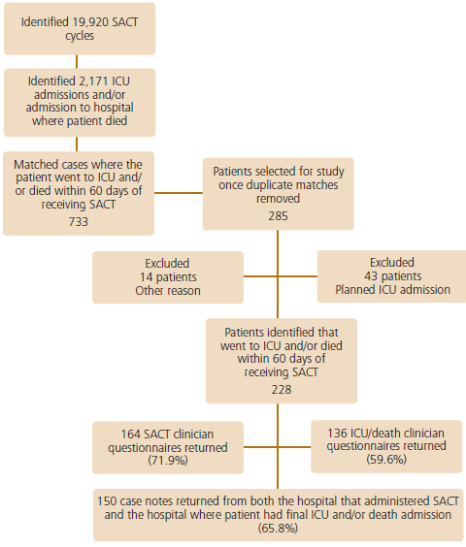
Study sample
Notes:
Presenter’s notes:
Over the study period almost 20,000 SACT cycles and more than 2,000 admissions to hospital were identified.
733 cases were matched to find those patients who went to critical or died within 60 days of receiving SACT.
From these 285 were selected for the study.
57 patients were excluded from the study.
For the remaining 228 patients, questionnaires completed by clinicians about SACT and ICU stay or death were received. Case notes were also received from the hospitals that administered SACT and where the patients had their final ICU admission and/or admission at the time of death.

Slide 5
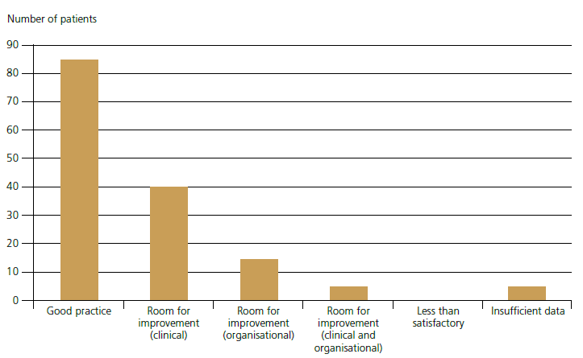
Overall quality of care
Notes:
Presenter’s notes:
Out of 150 cases, the case note reviewers rated the quality of care as good in 85 (58.6%).
There was room for improvement of clinical aspects of care in 40 (27.6%) of cases.
There was room for improvement of organisational aspects of care in 15 (10.3%) of cases.
5 (3.4%) had room for improvement of both clinical and organisational aspects of care.
There were no patients for whom reviewers felt the overall care received was less than satisfactory.
For 5 patients reviewers did not feel they were able to grade the quality of care due to insufficient data.

Slide 6
Recommendation 1
Ensure that any new protocol of systemic anti-cancer therapy, to a given patient, is discussed at a multidisciplinary team meeting, in advance of commencing treatment.
Notes:
Presenter’s notes:
This recommendation is aimed at Medical Directors, Directors of Nursing, Consultants, Pharmacists and Specialist Nurses.
Any new protocol of systemic anti-cancer therapy should be discussed at a multidisciplinary team meeting, in advance of commencing treatment.

Slide 7
Recommendation 3
Ensure that discussions about systemic anti-cancer therapy (SACT) with patients and/or their parents are documented and include:
  the intent of therapy (curative versus palliative)
  the chances of cure or the benefits of palliative therapy
  the risk of toxicity including that SACT can be life threatening
  ceilings of treatment in patients with a poor prognosis
Notes:
Presenter’s notes:
This recommendation is aimed at consultants.
Systemic anti-cancer therapy (SACT) should be discussed with patients and/or their parents. This should be documented and should include:
the intent of therapy, that is curative versus palliative
the chances of cure, or the benefits of palliative therapy
the risk of toxicity – this should include the fact that SACT can be life-threatening
ceilings of treatment in patients with a poor prognosis.

Slide 8
Recommendation 4
A nationally agreed consent form specific for systemic anti-cancer therapy should be developed and implemented. It should include:
  the intent of therapy
  an assessment of the chance of cure
  the risk of toxicity and
  the potential risk of death
Notes:
Presenter’s notes:
This recommendation is not aimed at clinical services but at national governments (NHS England, Welsh Government, Scottish Government and the Department of Health in Northern Ireland).

Slide 9
Recommendation 12
Ensure consultant review within 14 hours of an acute admission in line with the Royal College of Paediatrics and Child Health in ‘Facing the Future’ and the Royal College of Physicians of London in the ‘Acute Care Toolkit 4’.
Notes:
Presenter’s notes:
This recommendation is aimed at Medical Directors, Directors of Nursing and Consultants.

Slide 10
Discussion
Are new protocols of SACT discussed at multidisciplinary team meetings, in advance of commencing treatment? Do we have evidence of this?
Do we have discussions with patients and parents about SACT? Do we include all relevant information?
Does consultant review usually happen within 14 hours of an acute admission?
Do we have a policy for treatment with SACT?
At what ages are assent and consent sought?
Notes:
Presenter’s notes:
These questions can be used to generate discussion or you can use your own.

Slide 11
On The Right Course?
Full report, summary and implementation tools are be found at
www.ncepod.org.uk/2018cictya.html
Notes:
Presenter’s notes:
The full report, as well as a summary document, recommendation checklist and other support tools can be found on the NCEPOD website.

